Slide 1
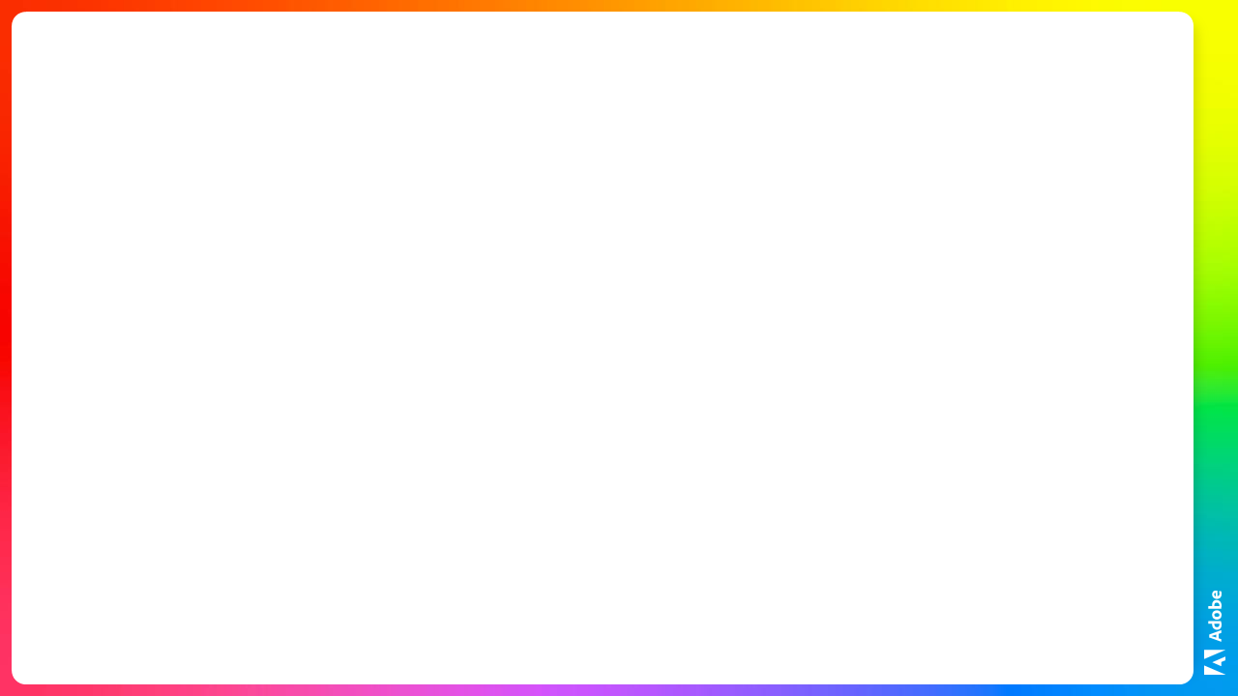
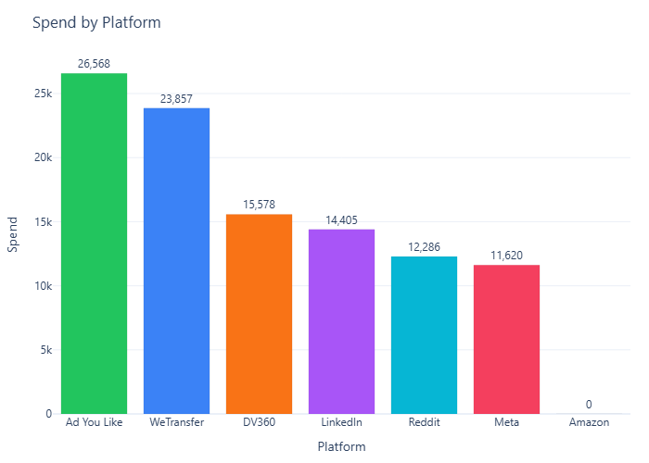
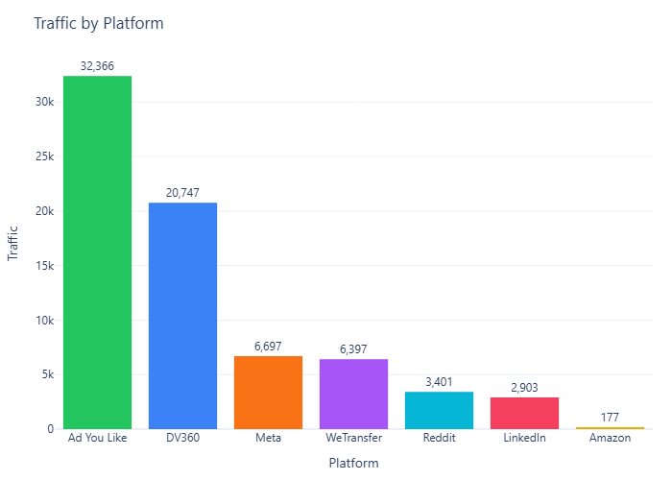
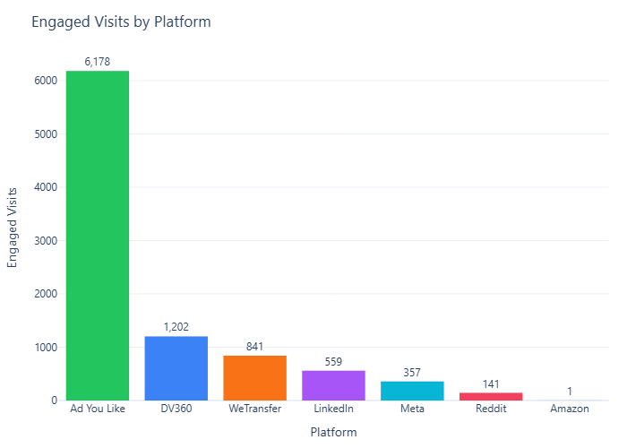
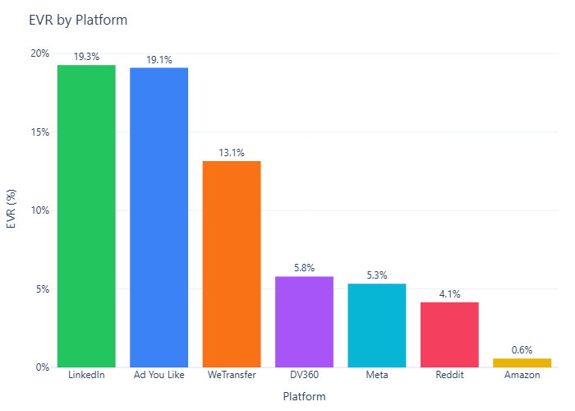
Acrobat Studio_Progression
Contributes 0.7% of this campaign’s engaged visits this week.
Engagement rate is 10.1% and moved up WoW.
Highest contribution comes from **Ad You Like**.

